Slide 1
The r’s Complement
N, a positive number.
r is the base of N with an integer part of n digits.
The r’s complement of N is defined as r^{n}-N for N≠0.
Find 10’s complement of (25.639)₁₀
Here N=25.639, r=10, n=2
So Answer will be 10²-25.639=74.361
Find 2’s complement of (1011.101)₂
Here N=1011.101,r=2,n=4
So answer will be (2⁴)₂-1011.101=10000-1011.101=0100.011

Slide 2
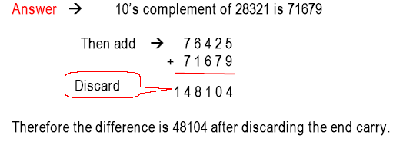
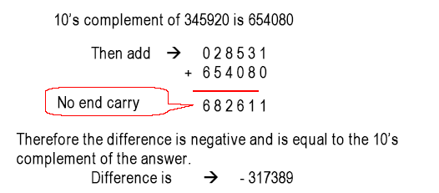
Substraction with r’s Complements Example
Subtract (76425 – 28321) using 10’s complements.
Substract (28531 – 345920)

Slide 3
Substraction with r’s Complements Example
Subtract (11010011 – 10001100) using 2’s complement.
2’s complement of 10001100 is 01110100
1 1 0 1 0 0 1 1
+ 0 1 1 1 0 1 0 0
Carry 1 0 1 0 0 0 1 1 1
The difference is positive and is equal to 01000111
Q: Subtract (1000100 –1010100) using 2’s complement.
2’s complement of 1010100 is 0101100
1000100
+ 0101100
no carry 1110000
Answer will be 2’s complement of 1110000= – 0001000

Slide 4
The (r-1)’s Complement
N, a positive number.
r is the base of N with an integer part of n digits and fraction part of m digits.
The (r-1)’s complement of N is defined as r^{n}-r^{-m}-N for N≠0.
Find 9’s complement of (25.639)₁₀
Here N=25.639, r=10, n=2 and m=3
So Answer will be 10²-10⁻³-25.639=99.999-25.639=74.361
Find 1’s complement of (1011.101)₂
Here N=1011.101, r=2, n=4 and m=-3
So answer will be (2⁴)₂-(2⁻³)₂-1011.101=1111.111-1011.101=0100.010

Slide 5
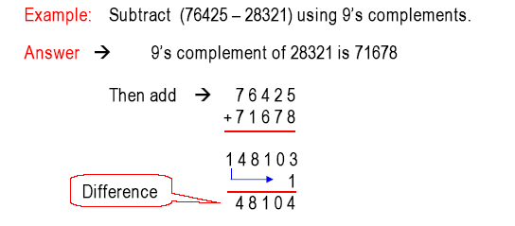
Substraction with (r-1)’s Complements example
Example: Suntraction (28321 – 76425) using 9’s complements
Answer 9’s complement of 76425 is 23574
Then add 28321
+23574
51895
Answer will be 9’s complement of 51895 is – 48104

Slide 6
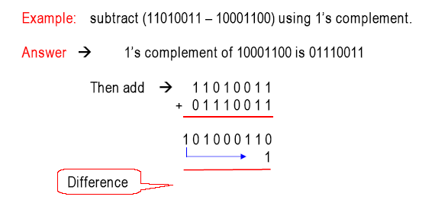
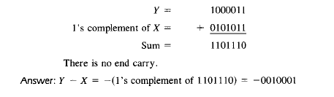
Substraction with (r-1)’s Complements example
Example: Perform subtraction operation Y-X=1000011-1010100

